Slide 1
Wisdom
Monday Reflection
Botticelli

Slide 2
Wisdom
Monday Prayers
Let us ask God to help us realise that in searching for Truth we are searching for Christ, His divine Son.
Lord, hear us…
Let us pray for those nations whose governments prevent their citizens in the pursuit of truth. May they be set free to grow in Wisdom.
Lord, hear us…
St. Philip: Pray for us.
House Saint: Pray for us.
In the name…

Slide 3

Wisdom
Tuesday Reflection

Slide 4
Wisdom
Tuesday Prayers
Maleki
Let us pray for those who are beginning to revise for their public exams, that they learn the art of focusing on the goal of their studies,
and avoid distractions.
Let us ask our Lady, Seat of Wisdom, to pray for them. Hail Mary…
St Thomas Aquinas: Pray for us In the name…

Slide 5
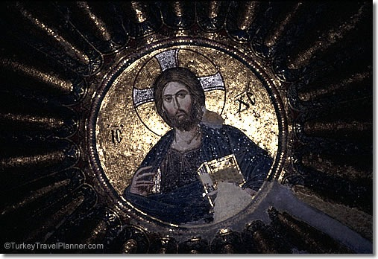
Wisdom
Wednesday Reflection
Hagia Sophia

Slide 6
Wisdom
Wednesday Prayers
Let us ask Him to come near to us in our studies and in our searching for the Truth, as we say together…
Our Father…
St. Philip: Pray for us.
House Saint: Pray for us.
In the name of the Father, and of the Son, and of the Holy Spirit. Amen.

Slide 7
Wisdom
Thursday Rosary
The Fifth Joyful Mystery:
THE FINDING OF JESUS IN THE TEMPLE
After three days Mary and Joseph found Jesus in the Temple, sitting among the teachers, listening to them and asking them questions. And all who heard him were amazed at his understanding and his answers.

Slide 8
Friday Prayer
Remember that you can go to the Chapel for Confession this lunchtime.
ST THOMAS’S PRAYER FOR STUDENTS
Ineffable Creator,
Pour forth a ray of Your brightness
into the darkened places of my mind;
disperse from my soul the twofold darkness into which I was born:
sin and ignorance.
You make eloquent the tongues of infants;
Refine my speech
and pour forth upon my lips
the goodness of Your blessing.
Grant to me keenness of mind,
capacity to remember, skill in learning,
subtlety to interpret, and eloquence in speech.
May You guide the beginning of my work,
direct its progress, and bring it to completion.
Amen.

