Slide 1
St. John Henry Newman
Monday Reflection

Slide 2
St. John Henry Newman
Monday Prayer
Holman Hunt
In a poem, Saint John Henry wrote: ‘Lead kindly light amid the encircling gloom, lead Thou me on.’
Let us pray that we too might look towards Christ as our guiding light, when we seem lost and in the dark.
Lord, hear us…
St. Philip: Pray for us. St. John Henry Newman: Pray for us.
House Saint: Pray for us. In the name of the Father…

Slide 3
St. John Henry Newman Tuesday Reflection
Blake

Slide 4
St. John Henry Newman
Tuesday Prayer
For Newman, God speaks to us primarily in our hearts, through the voice of conscience. Let us ask for the grace to hear His voice more clearly.
Lord, hear us…
Let us ask Mary, Seat of Wisdom, to pray for us.
Hail Mary….
St. Philip: Pray for us.
St. John Henry Newman: Pray for us.
House Saint: Pray for us.
In the name of the Father…
Garnet

Slide 5
St. John Henry Newman
Wednesday Reflection
Friedrich

Slide 6
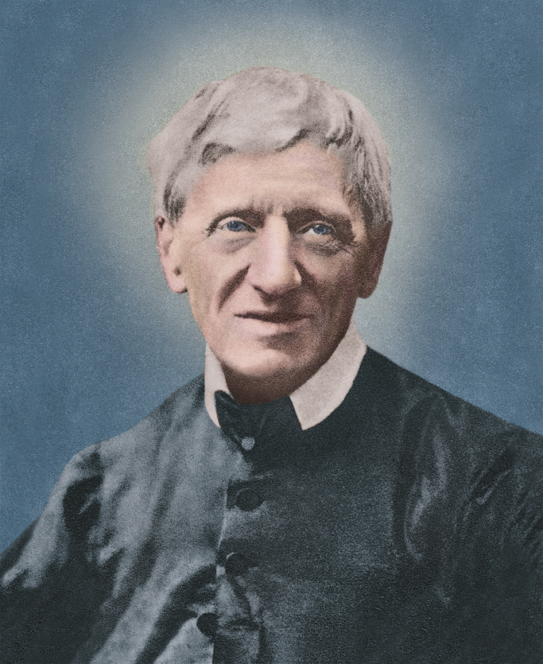
St. John Henry Newman Wednesday Prayer
Let us ask God to help us recognise when we are being arrogant enough to think we have all the answers. We pray for the gift of humility.
Lord hear us…
Let us ask God to inspire us to go often to Confession, so that we become more aware of God’s loving mercy towards us.
Lord hear us…
St. Philip: Pray for us.
St. John Henry Newman: Pray for us.
House Saint: Pray for us.
In the name of the Father…

Slide 7
Thursday Rosary
Duccio
Third Mystery of Light:
JESUS PREACHES THE KINGDOM OF GOD
Jesus came to Galilee, proclaiming the good news of God, and saying, ‘The time is fulfilled, and the kingdom of God has come near; repent, and believe in the good news.

Slide 8
Friday Prayer
PRAYER TO SAINT JOHN HENRY NEWMAN
O God, who bestowed on
Saint John Henry Newman
the grace to follow your kindly light
and find peace in your Church;
graciously grant that,
through his intercession and example,
we may be led out of shadows and images
into the fullness of your truth.
Through Christ our Lord, Amen.

