Slide 1
Mary & the Rosary Monday Reflection
Leonardo da Vinci

Slide 2
Mary & the Rosary Monday Prayer
Let us ask Mary, conceived without sin, to pray for us who have need of her prayers.
Hail Mary….
St. Philip: Pray for us.
House Saint: Pray for us.
In the name…
Leonardo da Vinci

Slide 3
St Philip Neri Tuesday Reflection
Torchlight Procession at Lourdes

Slide 4
Mary & the Rosary
Tuesday Prayer
Let us ask Mary, conceived without sin, to pray for us who have need of her prayers.
Hail Mary….
St. Philip: Pray for us.
House Saint: Pray for us.
In the name of the Father…
Raphael

Slide 5
Mary & the Rosary Wednesday Reflection
Madonna of Częstochowa

Slide 6
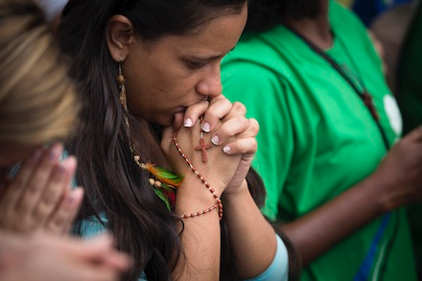
Mary & the Rosary Wednesday Prayer
We pray for those in our school whose families are broken and unloving; May they draw near to Mary and ask for her prayers.
Lord hear us.… Lord graciously hear us.
Let us ask Mary, conceived without sin, to pray for us who have need of her prayers.
Hail Mary….
In the name…

Slide 7
Thursday Rosary
Lippi
Fifth Glorious Mystery:
THE CORONATION OF THE BLESSED VIRGIN
A great portent appeared in heaven: a woman clothed with the sun, with the moon under her feet, and on her head a crown of twelve stars.

Slide 8
Friday Prayer
THE MEMORARE
Remember, O most loving Virgin Mary,
that it is a thing unheard of
that anyone ever had recourse to thy protection,implored thy help,
or sought thy intercession
and was left forsaken.
Filled therefore with confidence,
I fly to thee, O Mother, Virgin of virgins; to thee do I come;
before thee I stand, a sorrowful sinner.
Despise not my words
O Mother of the Word of God,
but graciously hear and grant my prayer. Amen.
Raphael

