Slide 1
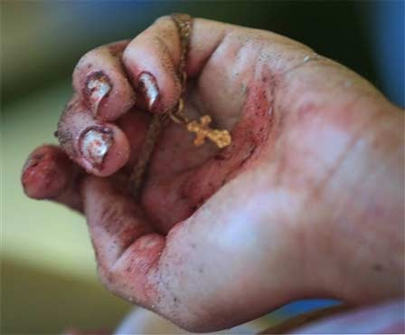
Lent
Monday Reﬂection

Slide 2
Lent
Monday Prayers
Let us pray for those who are being
persecuted for their faith.
May the work of Aid to the Church in Need bring
them hope in their times of trial and
hardship.
Lord, hear us…
Let us pray for those who risk their own lives
working to support our brothers and sisters.
May the Lord give them the gift of fortitude.
Lord, hear us…
St. Philip: Pray for us.
House Saint: Pray for us.
In the name…

Slide 3
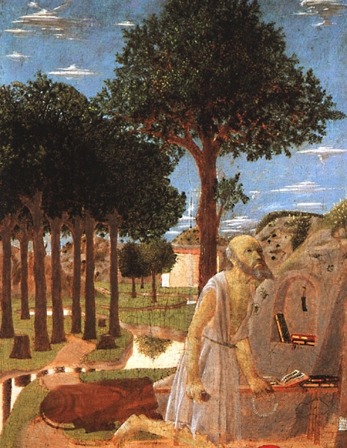
Lent
Tuesday Reﬂection
Piero della Francesca

Slide 4
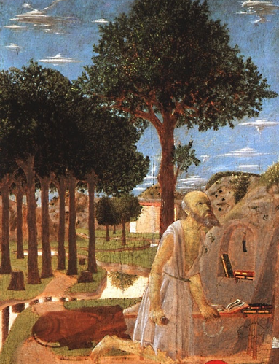
Lent
Tuesday Prayers
Let us pray that we ﬁnd the courage to
persevere in our Lenten resolutions.
Lord, hear us…
Let us pray for those who are being
persecuted for their faith. May the
work of Aid to the Church in Need bring
them hope in their times of trial and
hardship.
Lord, hear us…
St. Philip: Pray for us.
House Saint: Pray for us.
In the name…

Slide 5
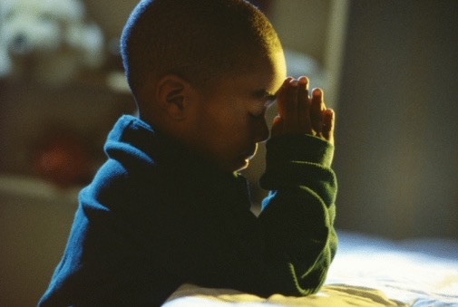
Lent
Wednesday Reﬂection

Slide 6
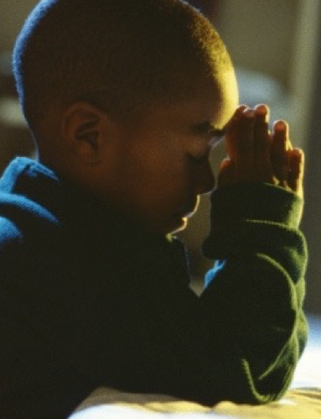
Lent
Wednesday Prayers
Let us pray that we ﬁnd the courage to
persevere in our Lenten resolutions.
Lord, hear us…
Let us pray for those who are being
persecuted for their faith. May the
work of Aid to the Church in Need bring
them hope in their times of trial and
hardship.
Lord, hear us…
St. Philip: Pray for us.
House Saint: Pray for us.
In the name…

Slide 7
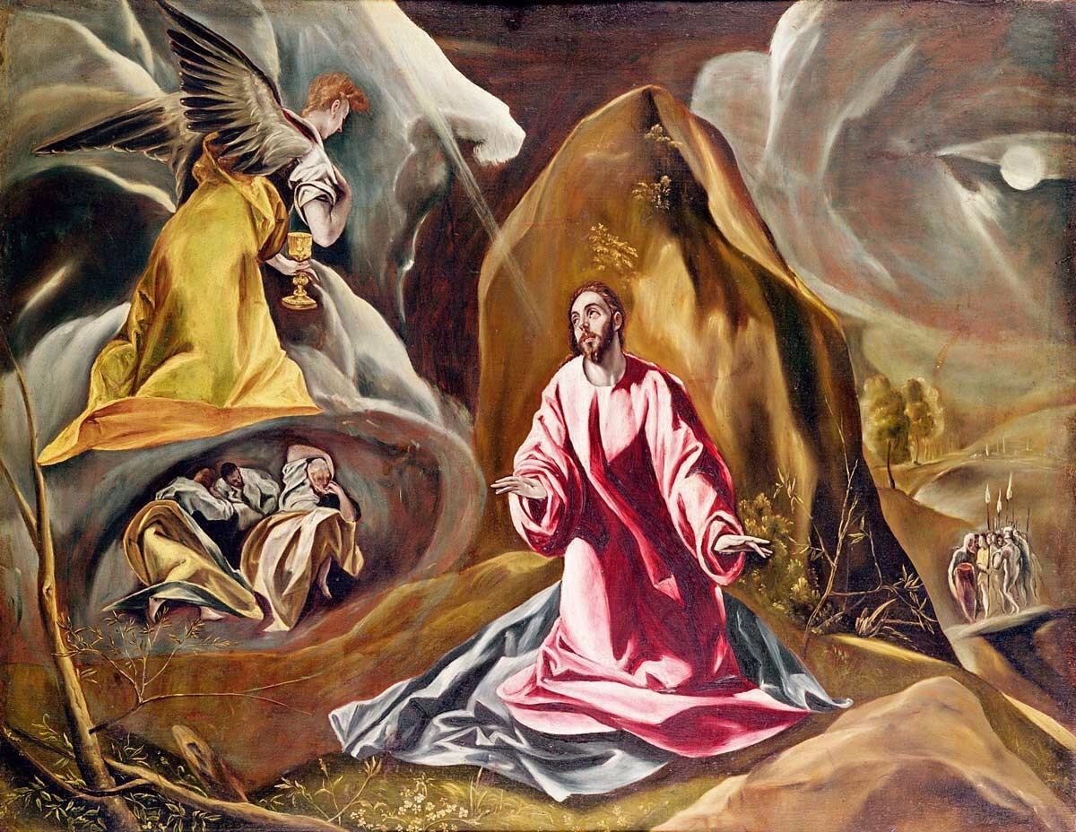
Lent
Thursday Rosary
El Greco
FIRST SORROWFUL MYSTERY:
THE AGONY IN THE GARDEN
In his anguish, Jesus prayed more earnestly, and his sweat became like great drops of blood falling down on the ground.

Slide 8
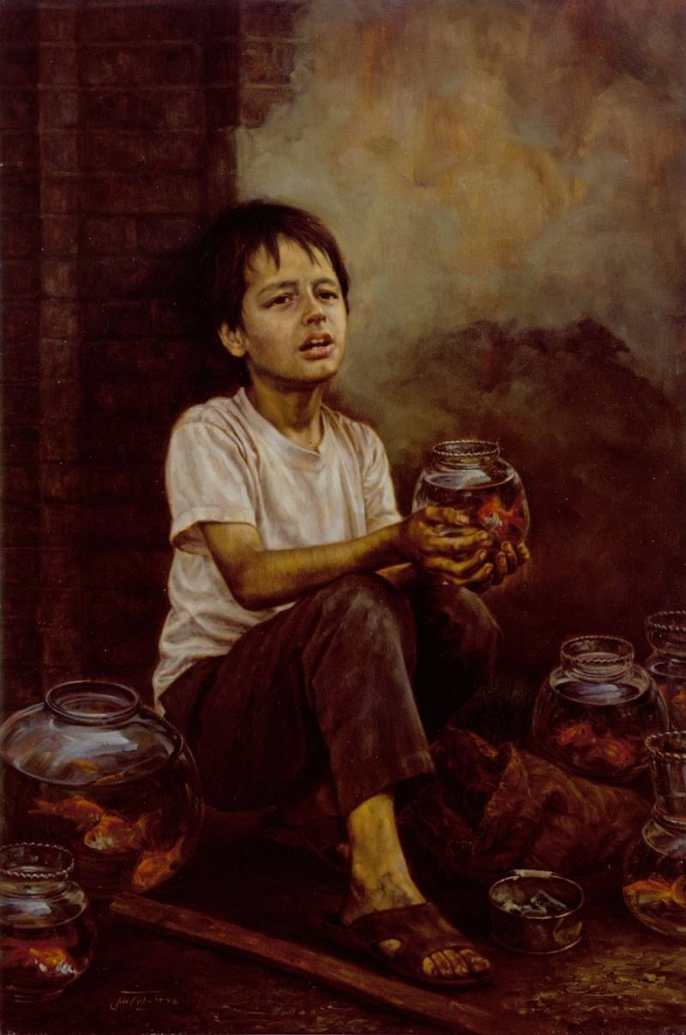
Friday Prayer
Remember that you can go to the Chapel for Confession this
lunchtime.
PRAYER FOR LENT
Bless us Lord, as you call us
to walk with you on this Lenten Journey.
Bless us Lord, as you remind us
that our purpose is to please you rather
than pleasing ourselves.
Bless us Lord, as we seek the good of
others
in our prayers, fasting and alms-giving.
Maleki

