Slide 1
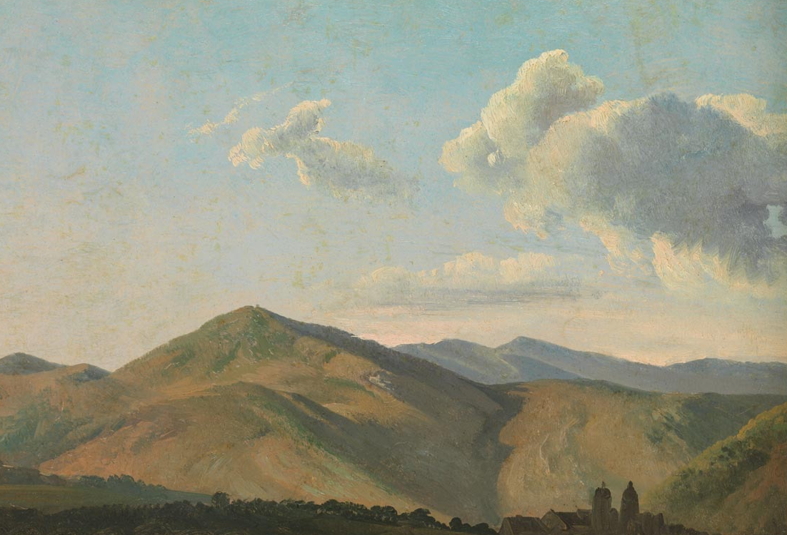
The Ascension of the Lord
Monday Reflection
Simon Denis

Slide 2
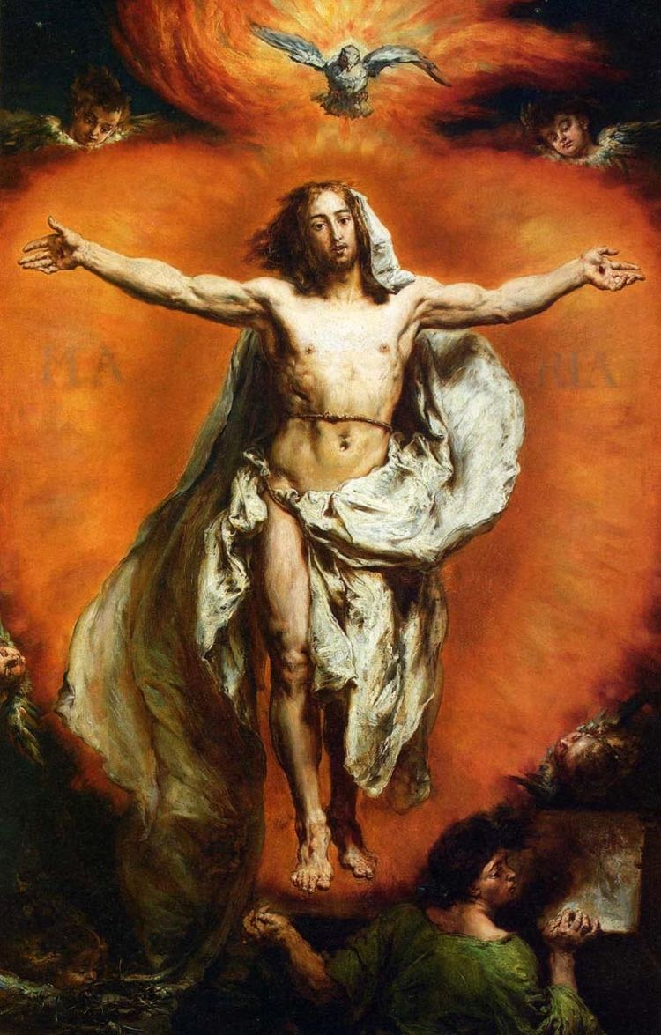
The Ascension of the Lord
Monday Prayers
Let us pray
for those who struggle to find Christ,
and have lost all sense of hope.
May they find the Lord in their lives.
Lord, hear us....
St Philip: Pray for us.
House Saint: Pray for us.
In the name…
Jan Matejko

Slide 3
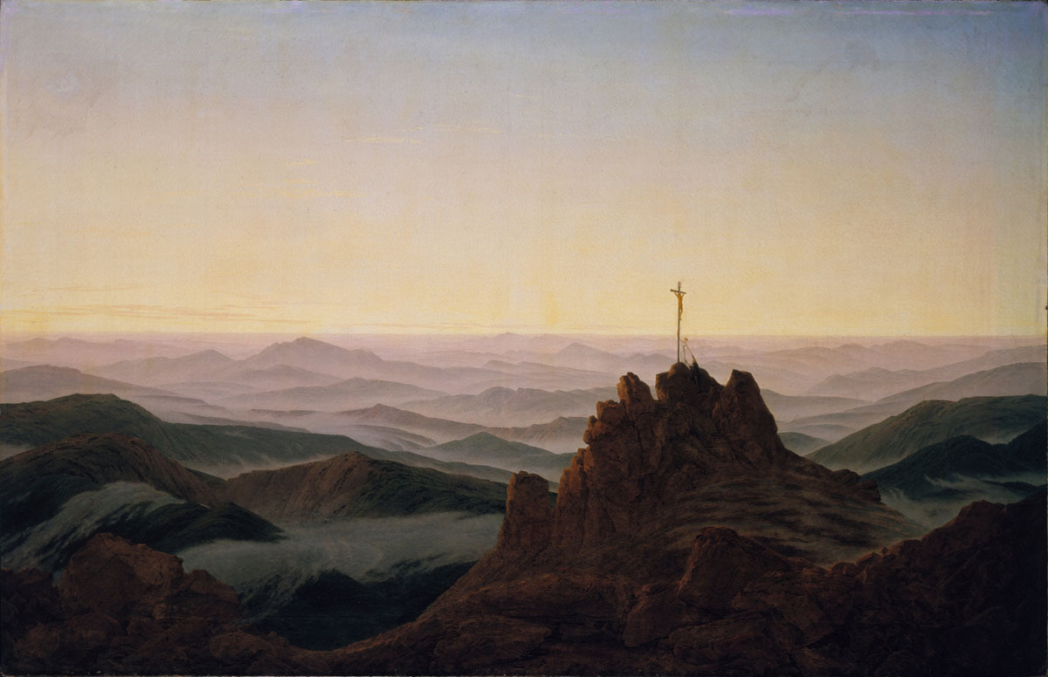
The Ascension of the Lord
Tuesday Reflection
Caspar Friedrich

Slide 4
The Ascension of the Lord
Tuesday Prayers
Let us pray the Universal Church,
that all the peoples of the world
are united within her,
and grow in support of each other to spread the Gospel of Christ
more effectively..
Lord, hear us…
St Philip: Pray for us.
House Saint: Pray for us.
In the name…
Taddeo di Bartolo

Slide 5
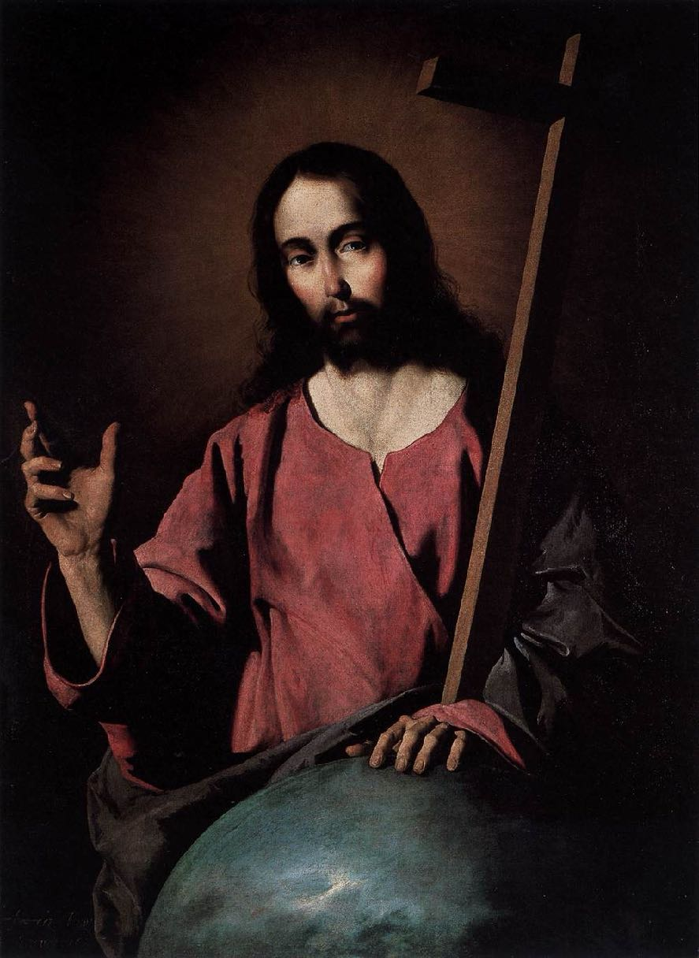
The Ascension of the Lord
Wednesday Reflection
Zurbarán

Slide 6
The Ascension of the Lord
Wednesday Prayers
Let us pray for those who have strayed from this mission,
and who create divisions and factions in the Church.
May they find the peace that comes only from the Prince of Peace
through his Church,
his body on earth.
Lord, hear us…
St Philip: Pray for us.
House Saint: Pray for us.
In the name…
Perugino

Slide 7
Thursday Rosary
The Second Glorious Mystery:
THE ASCENSION
After he had spoken to them, the Lord Jesus was taken up into heaven and sat down at the right hand of God. And they went out and proclaimed the good news everywhere, while the Lord worked with them and confirmed the message by the signs that accompanied it.
Pietro Perugino

Slide 8
Friday Prayer
Remember that you can go to the Chapel for Confession this lunchtime.
PRAYER TO THE HOLY SPIRIT
V. Come, Holy Spirit, fill the hearts of your faithful
R. And kindle in them the fire of your love. V. Send forth your Spirit and they shall be created
R. And you will renew the face of the earth.
Let us pray.
Lord, by the light of your Holy Spirit you have taught the hearts of your faithful.
In that same Spirit help us to relish what is right and always rejoice in your consolation.
We ask this through Christ our Lord. Amen.
Memling

