Slide 1
War & Peace
11th November

Slide 2
War & Peace
11th November
They shall not grow old, as we that are left grow old.
Age shall not weary them, nor the years condemn.
At the going down of the sun, and in the morning
We will remember them.
We will remember them.
May they rest in peace. Amen

Slide 3
War & Peace
Monday Reflection

Slide 4
War & Peace
Monday Prayers
Let us say the Lord’s prayer for those who sacrificed their lives in the defence of peace.
Our Father….

Slide 5
War & Peace
Tuesday Reflection
Banksy

Slide 6
War & Peace
Tuesday Prayers
Let us pray for those who gave their lives in the cause of peace.
Eternal rest grant unto them O Lord.
And let perpetual light shine upon them.
May they rest in peace.
Amen.
Our Father…
St. Philip: Pray for us.
House Saint: Pray for us.
In the name of the Father…
Banksy

Slide 7
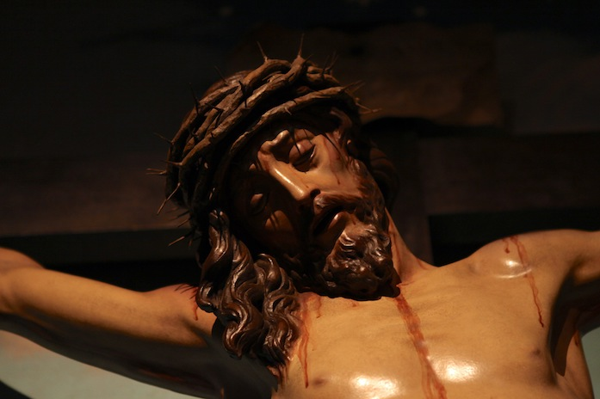
War & Peace
Wednesday Reflection
Calvary,
Oratory Church

Slide 8
War & Peace
Wednesday Reflection & Prayers
Let us ask Mary, Queen of Peace, to pray for us, that we may find true peace on earth.
Hail Mary….
St. Philip: Pray for us.
House Saint: Pray for us.
In the name of the Father, and of the Son, and of the Holy Spirit. Amen.
Calvary,
Oratory Church

Slide 9
War & Peace
Thursday Rosary
Fifth Sorrowful Mystery: THE CRUCIFIXION
“Father, into your hands I commend my spirit”

Slide 10
Friday Prayer
Prayer of Saint John XXIII
Lord Jesus Christ, who are called the Prince of Peace, who are yourself our peace and reconciliation,
who so often said, "Peace to you,”
grant us peace. Make all men and women
witnesses of truth, justice,
and brotherly love. Banish from their hearts
whatever might endanger peace.
Enlighten our rulers
that they may guarantee and defend
the great gift of peace.
May all peoples on the earth
become as brothers and sisters. May longed-for peace blossom forth
and reign always over us all.
Amen.
Calvary,
Oratory Church

