Slide 1
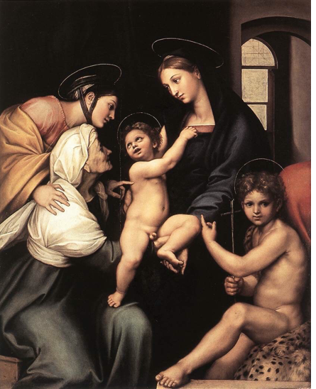
St John the Baptist
Monday Reﬂection
Raphael

Slide 2
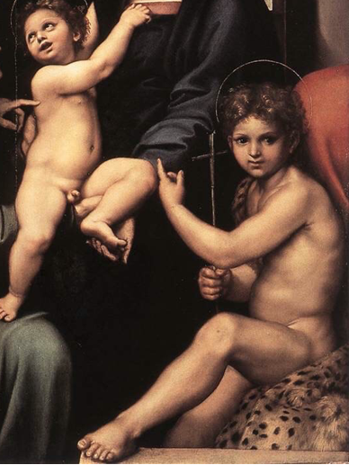
St John the Baptist
Monday Prayer
Let us pray for those who promote
the culture of abortions and refuse
to recognise the human dignity of
unborn babies.
May they be enlightened by the
Word made ﬂesh.
St John the Baptist: Pray for them.
In the name....
Raphael

Slide 3
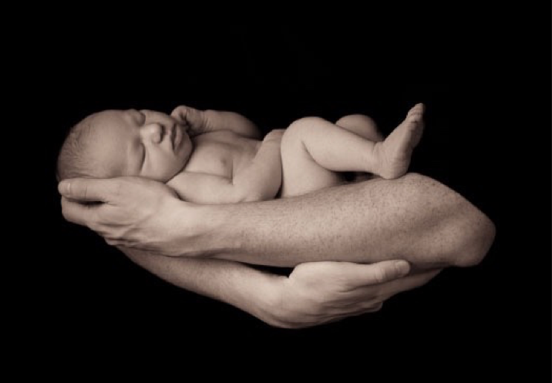
Birthdays
Tuesday Reﬂection
Newborn Baby

Slide 4
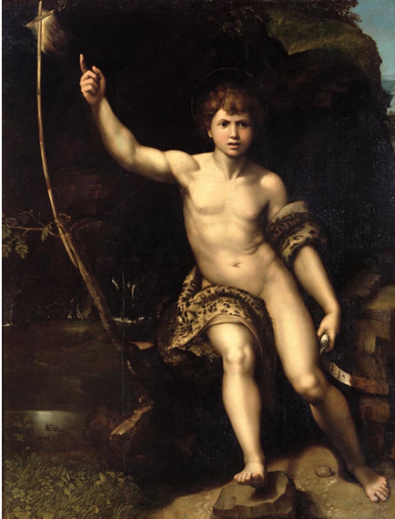
Birthdays
Tuesday Prayer
Let us thank Almighty God for the
gift of life, and pray for our parents,
who co-operated with Him bringing
us to our birthday.
Lord, hear us....
Let us say together the Lord’s Prayer.
Our Father…
St John the Baptist: Pray for us,
House Saint: Pray for us.
In the name of the Father…
Raphael

Slide 5
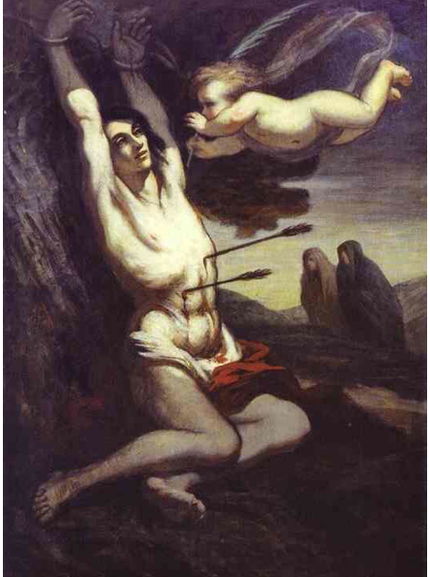
Dying into Life
Wednesday Reﬂection
Daumier

Slide 6
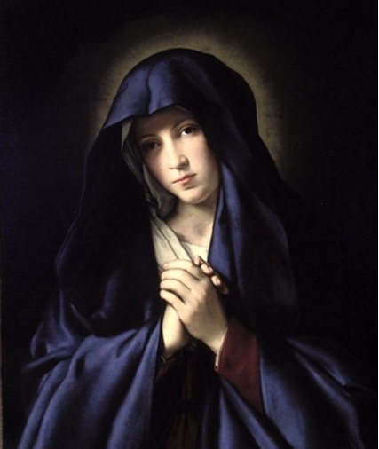
Dying into Life
Wednesday Prayer
Let us say together the Hail Mary,
and really think about what we are
praying for when we pray
‘Now and at the hour of our
death’.
Hail Mary…
In the name....
Sassoferrato

Slide 7
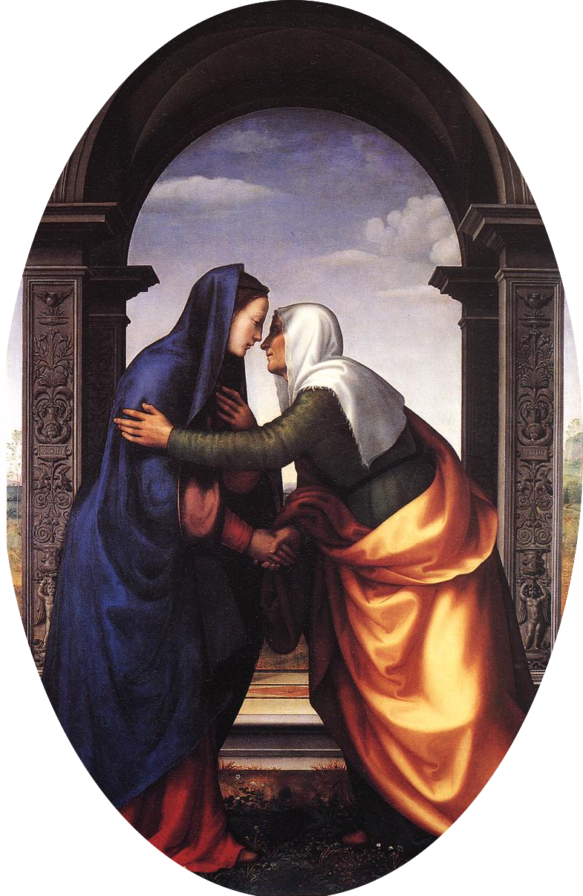
Thursday Rosary
SECOND JOYFUL
MYSTERY:
THE VISITATION
At the approach of Mary and Jesus,
the child in the womb of Elizabeth
leapt for joy.
Albertinelli

Slide 8
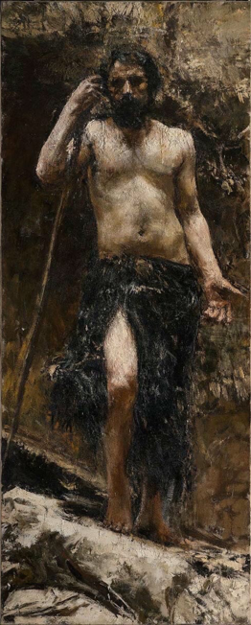
Friday Prayer
From the
THE BENEDICTUS
Little child, you shall be called
a ‘Prophet of God the Most High’.
You shall go ahead of the Lord
to prepare his ways before him,
to make known to his people their salvation
through the forgiveness of all their sins,
the loving-kindness of the heart of our God
who visits us like the dawn from on high.
He will give light to those in darkness,
those who dwell in the shadow of death,
and guide us into the way of peace.
Glory be…
Antonio Mancini

